Slide 1

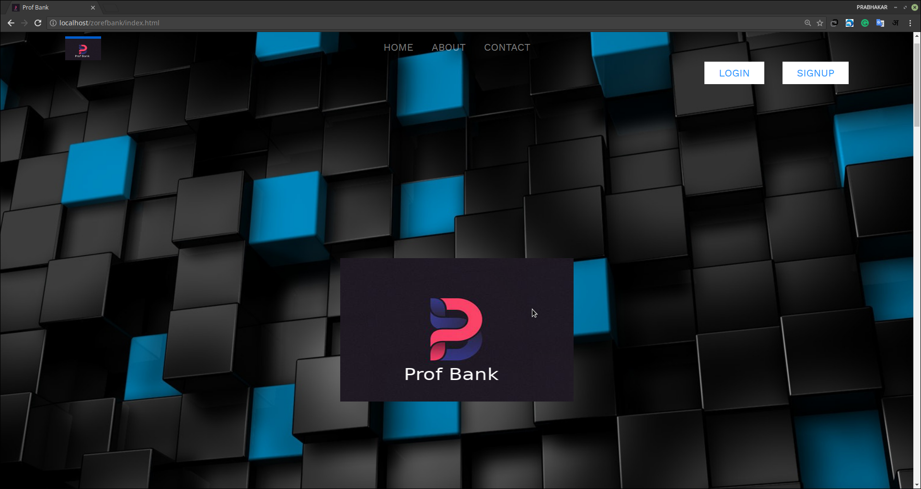
Online Banking
System
MINI PROJECT
PHP, MYSQL, HTML, CSS, JAVASCRIPT
NOV 2018

Slide 2
Online Banking System
Group Members
ASHWANI LAHORIA (16BCS063)
MARVI KHAJURIA (16BCS062)
PRABHAKAR KUMAR ( 16BCSO35 )
SHRI MATA VAISHNO DEVI UNIVERSITY

Slide 3
INDEX
SERIAL NO. | TOPIC | PAGE NO.
1 | Acknowledgement | 3
2 | Requirement Specification | 4-5
3 | Database design | 6-8
4 | Screenshots | 9-12
5 | Sample codes | 13-24
6 | Future scope of improvement | 25
7 | conclusion | 26

Slide 4
Acknowledgment
This is to mention in a small way the help we got from various sources including the websites Google.com, w3schools.com, numerous online banking sites of HDFC, State Bank of India, Axis Bank, Canara Bank, Bank of India, Punjab National Bank, ICICI Bank, etc. We were also helped by a book “Advanced CSS”.Last but not the least we would always be grateful to our instructor Mr. Sudesh Kumar for his immense help throughout one course and project work.

Slide 5
Requirement Specification
Domain Description:
A system allowing individuals to perform banking activities at home, via the internet. Some online banks are traditional banks which also offer online banking, while others are online only and have no physical presence. Online banking through traditional banks enable customers to perform routine transactions such as transfer funds, balance inquiries, get mini statements, and stop-payment requests, and some even offer online loan applications. Account information can be accessed anytime, day or night, and can be done from anywhere. A few online banks update information in real time, while others do it daily. Once information has been entered, it doesn't need to be re-entered for similar subsequent checks, and future payments can be scheduled to occur automatically.

Slide 6
Functional Requirements:
As per the facilities provided by several online banking softwares, our project aims at covering the following functionalities to serve the customers having account in our bank in a better way
1. Opening new accounts.
2. Viewing the account details.
3. Getting ones accounts summary.
4. Obtaining mini statements.
5. Balance enquiry.
6. Transfer funds to another account in the same bank.
7 .Request for loan and sanctioning of the same.

Slide 7
Hardware Specification:
Pc with 4GB RAM and 1TB Hard Disk.

Slide 8
Software Specification:
Number | Description | Version
1 | XAMPP | 3.1.0
2 | Apache | 2.4.3(Win32) OpenSSL/1.0.1c PHP/5.4.7
3 | MySQL | 5.5.27-MySQL Community server
4 | Netbeans IDE | 7.1
5 | Operating System | Windows XP or Above

Slide 9
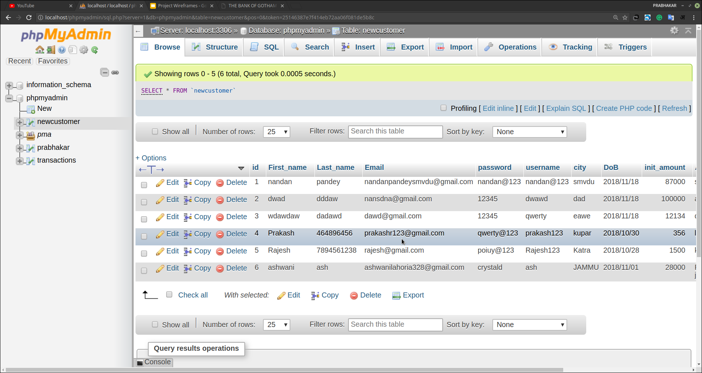
Table Description:
The database used in this project is ‘netbanking’using MySQL server.The database consists of the following tables:
The functionalities and attributes of each table are described in the next page:

Slide 10
Table
TABLE NAME | ATTRIBUTES | FUNCTIONALITY
Accountmaster | Accounttype, prefix, minbalance, interest | Details of all types of account.
Accounts | Ifsc code,branch name,city, branch address,state,country | Details of the bank’s branches.
Customers | Customerid,ifscode,firstname, lastname,Loginid,accpassword, transpasword,accstatus,city,state country,accopendate,last login | Details of the customer.

Slide 11
Employees | Empid,employee_name,loginid, passwordEmailid,contactno, createdat,last_login | Details of the bank’s employees
Loan | Loan id,loan type,loan amt, Interest,start date | Loan specification
Loan payment | Paymentid,date,paida mt, loan id | Details of the loans paid
Loan type | Loan type,prefix,maximum amt, minimum amt,Interest,status | Details of all types of loan
mail | Mail Id,subject,message, m date time,Sender id, receiver id | Details of received and sent mails

Slide 12
Registered_payee | Customerid,payeename, Accountnumber, Accounttype bankname,ifsccode | Details of the payee
Transaction | Transaction Id,Transaction Date,ment Payment Date, Received,Debit ac,amount,payment state | Details of transaction done.

Slide 13

Features:-
Totally Digital
Highly Secured
Cardless Transaction
Password Protected Account
Transaction History Record

Slide 14
What customers do today
Justify your effort to try to solve the problem.
Online Account Registration
Cardless Money Transfer
E-billing

Slide 15
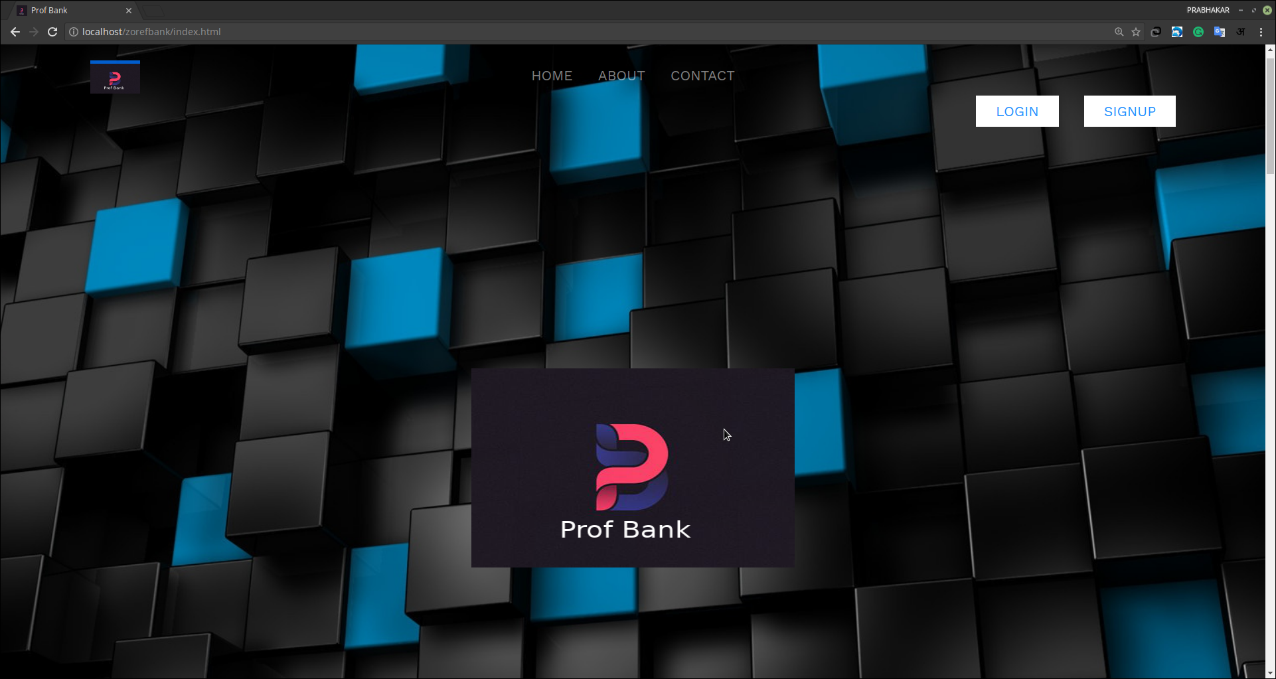
Screen Shots
There are several functions of the site. A few snapshots of some important pages of this site are shown below:
This is the login page of the bank.

Slide 16
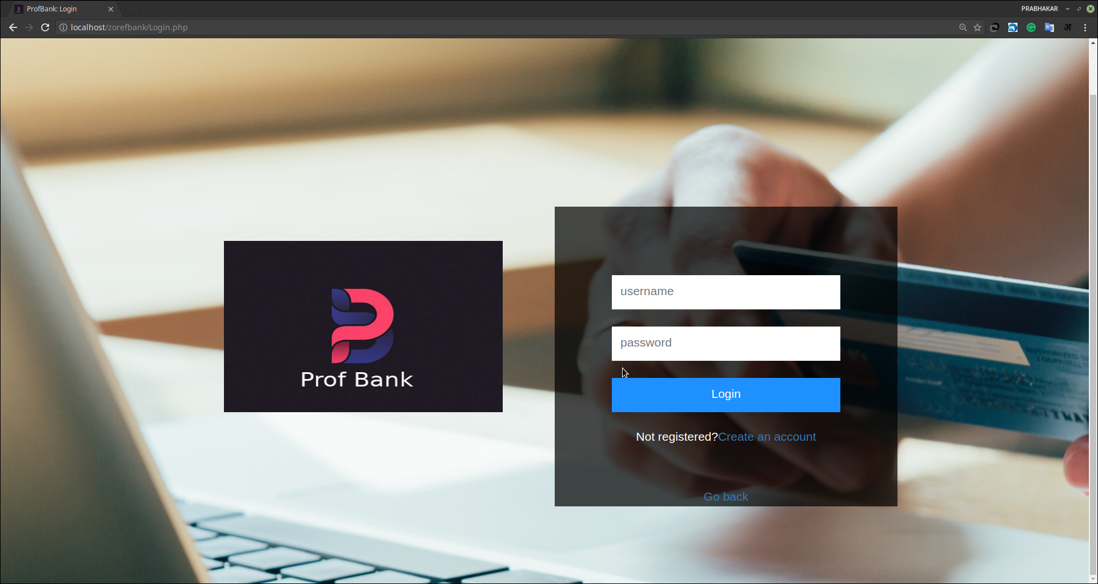
Loginpage:

Slide 17
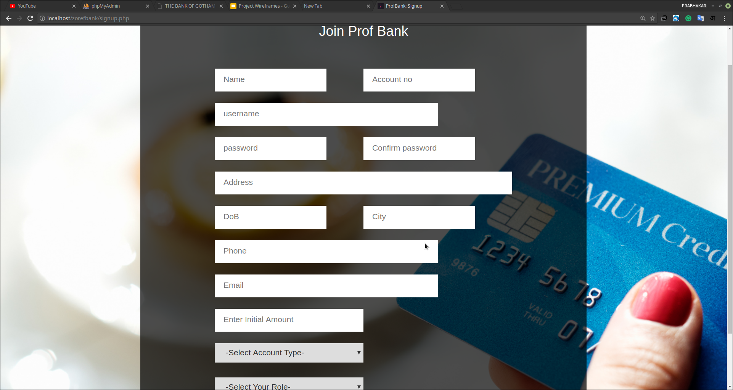
Signup Page:-

Slide 18
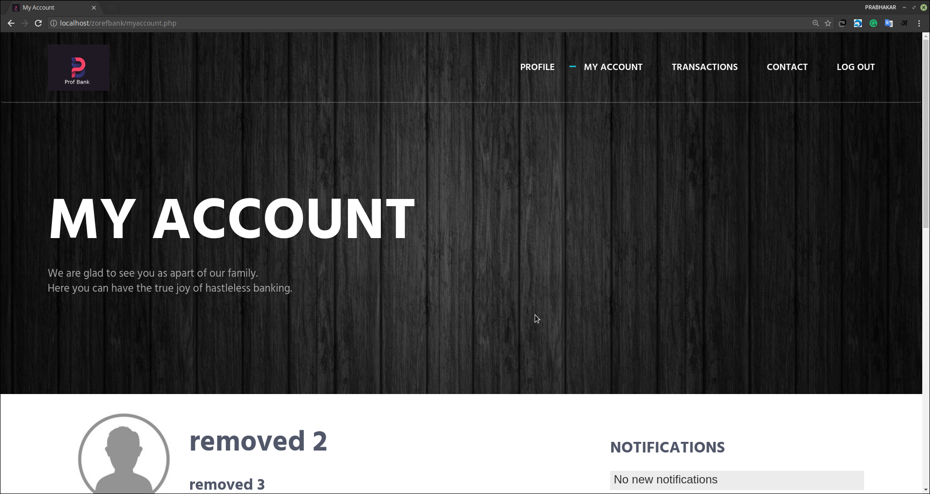
Account Section:-
This is the Account Section Of the User.

Slide 19

Future Scope Of Improvement :-
Our project aims at the delivery of proper services to the users, but still we lack some utilities. For this inconvenience we are trying to bring in as much facilities as possible. In our development process we will firstly attempt for the online deposit and withdrawal of money from the bank. We will try to make the system more secure and free it from any flaws currently present. To reduce the work of the administrator will be a major concern, where we shall attempt to shift the verifying activities of each account details from manually to the system.

Slide 20
Conclusion:-
This was a small attempt from our side to create a prototype of a system, vital nowadays in everyone’s life.
In spite of its drawbacks, hope it will serve the people upto a certain extent and on our side we shall try to enhance the system for the betterment of society.

Slide 21
Questions?

Slide 22
Thank You!

